Slide 1
MUSIC HOST INTERFACE
BEng. Hons. Computer And Electronic Engineering, GMIT
Student: Thomas Flynn
Supervisor: Brian O’ Shea

Slide 2
Contents
Background
Tools
JavaFX Media Player Application
Android Application
Summary
Conclusion

Slide 3
Background & Scoping
Personal
Demonstrate Abilities
Realization of Ideas
Initial Idea
Virtual Jukebox
Complete Idea
Music Host dictates what the guests can do.
The guest can...
-Request songs
-Skip songs
-Give the DJ feedback

Slide 4
Tools
JavaFX
Scene Builder 2.0
Media Player API
Animation API
Microsoft Azure Cloud Storage
User Login Credentials
User Songs
Bluetooth
BlueCove library
Android Bluetooth API

Slide 5
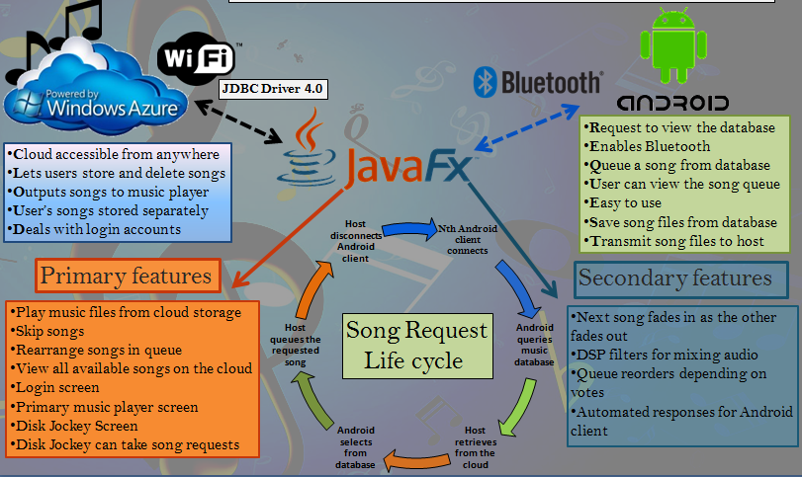
Christmas Poster

Slide 6
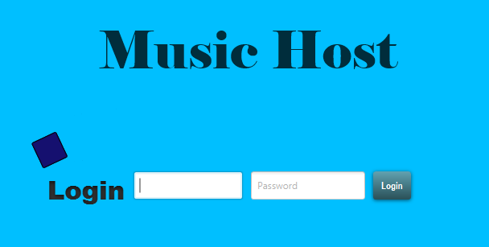
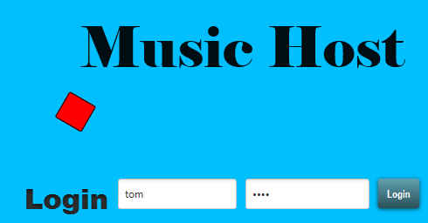
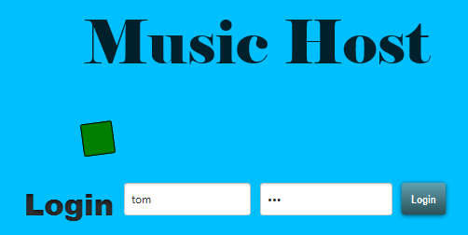
MEDIA PLAYER - LOGIN SCREEN
Login Credentials
Success/Fail
Animation
Login Button
Fail
Animation
Success
Animation

Slide 7
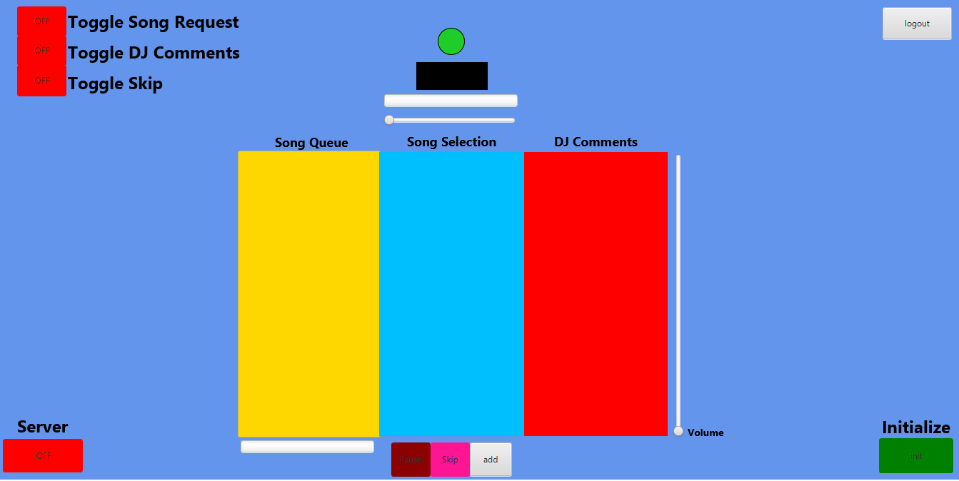
MEDIA PLAYER - MAIN SCREEN
Host Options
Logout Button
MediaView
Play Animation
Time Slider
Server Button
Download
Progress
Play, Skip, Add, Buttons
Volume Control
Start Button

Slide 8
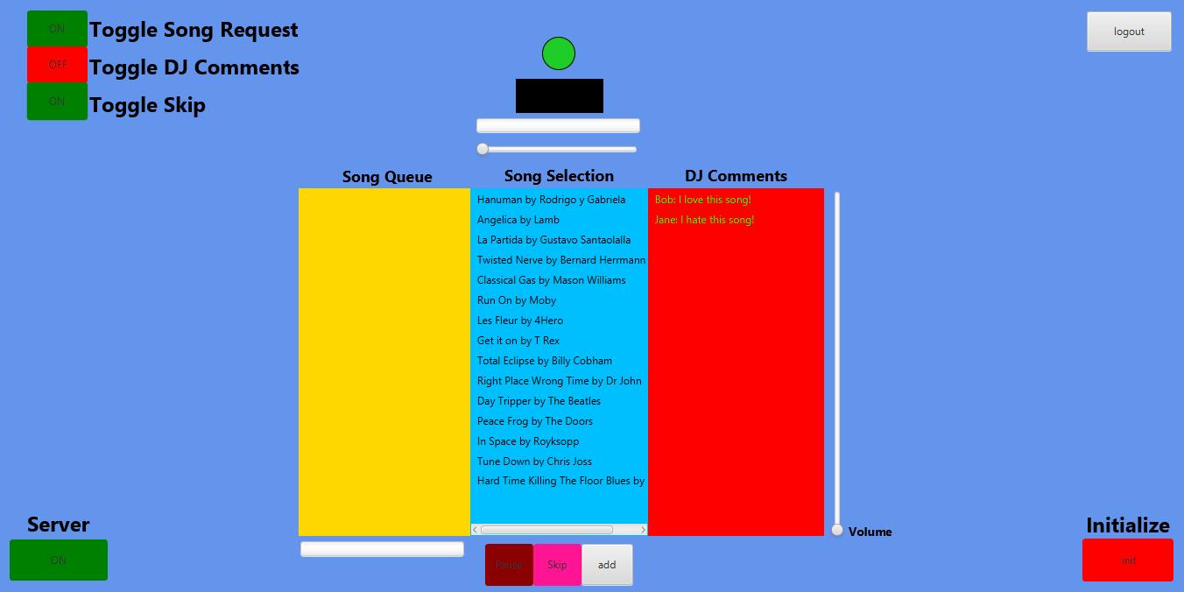
MEDIA PLAYER USE CASE – SETUP
Guest Options Specified
Server Enabled
Selection Populated
Initialized

Slide 9
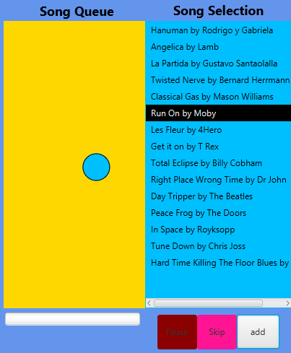
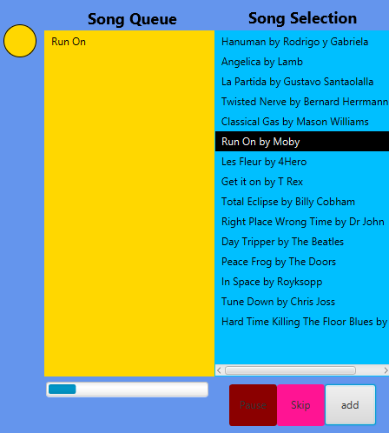
MEDIA PLAYER USE CASE - SONG ADDED
Animation Complete
Song added
Animation
Download Started
User Clicks

Slide 10
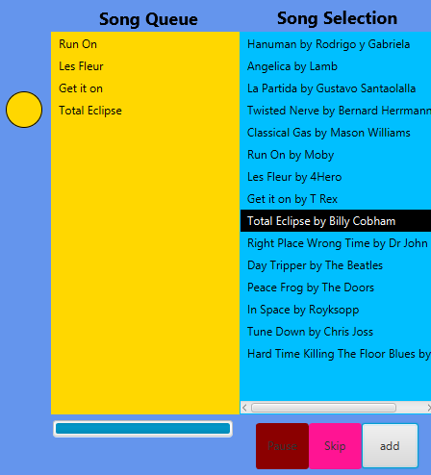
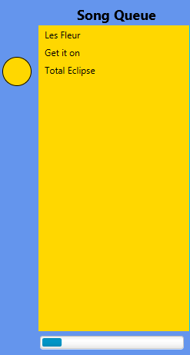
MEDIA PLAYER USE CASE - SONG SKIPPED / SONG ENDED
Next Song Plays
Circle Moves Up
Event Fired
Next Next Song Downloads

Slide 11
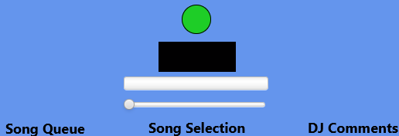
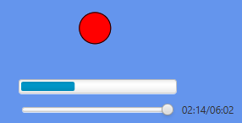
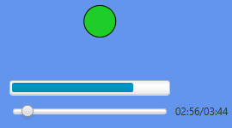
MEDIA PLAYER USE CASE – PLAY/PAUSE
Animation Not
Started
MediaView Empty
Animation Paused
Animation Playing

Slide 12
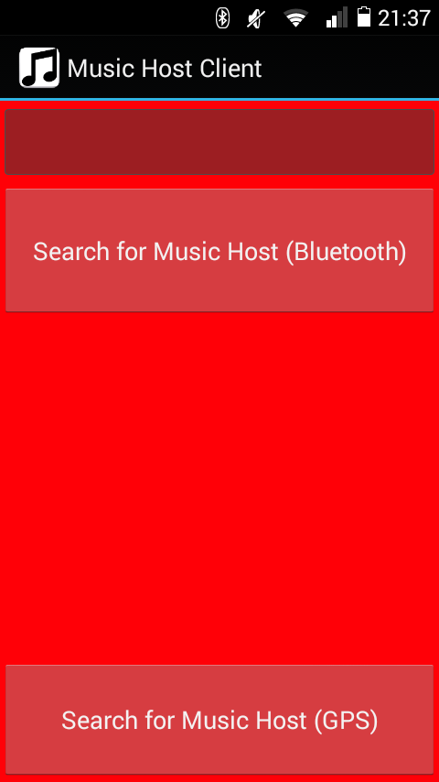
MUSIC HOST CLIENT USE CASE – OPEN APP
Edit TextField
DJ Comment
Button
BT Adaptor.startDiscovery
Song Request,
DJ Comment,
Skip Song
Invisible Buttons
Button
Azure Mobile Services

Slide 13
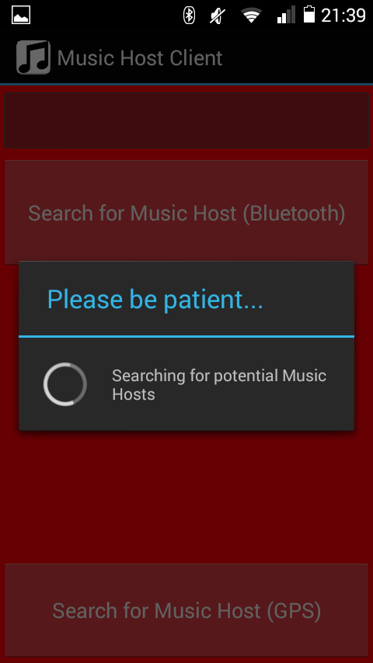
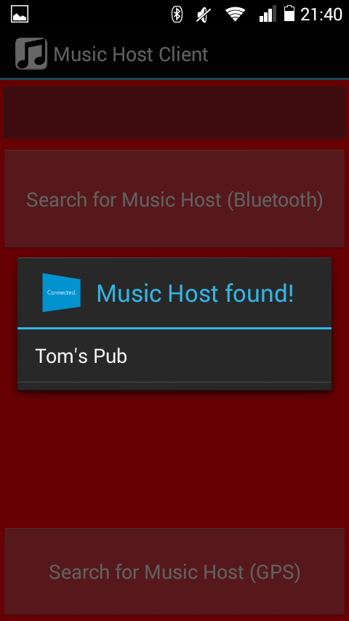
MUSIC HOST CLIENT USE CASE – SEARCH FOR MUSIC HOST (BT)
Music Host Found

Slide 14
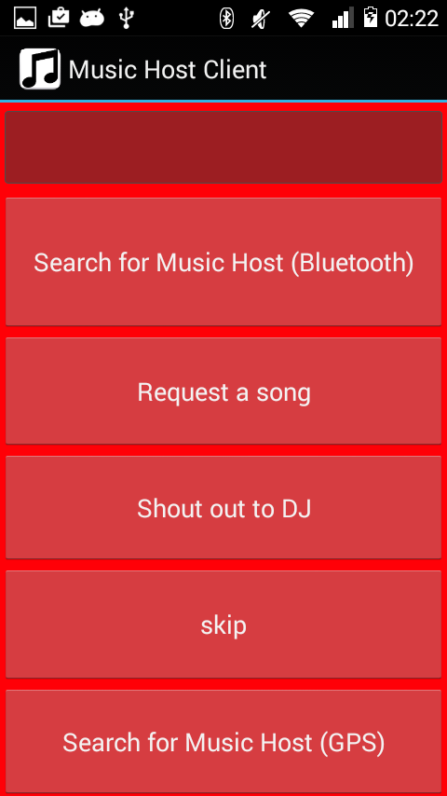
MUSIC HOST CLIENT USE CASE – CONNECTED

Slide 15
MUSIC HOST CLIENT USE CASE – Connected
Edit TextField
DJ Comment
Button
Send SONG_SELECT int
Button
Send DJ_COMMENT int
Button
Send DJ_COMMENT int

Slide 16
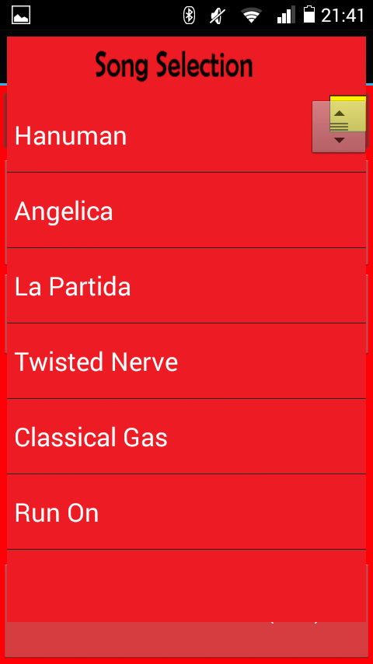
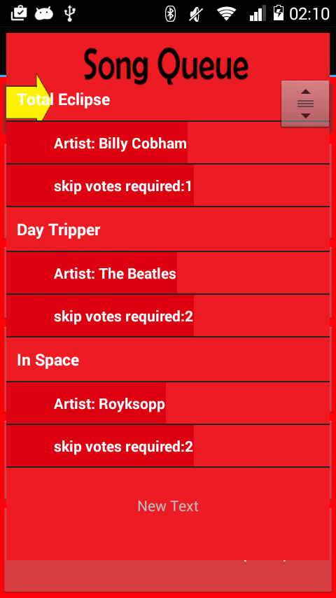
MUSIC HOST CLIENT USE CASE – SONG REQUEST
Selected
Song
Swipe
Left
Right
ViewFlipper Child 1
ViewFlipper Child 2

Slide 17
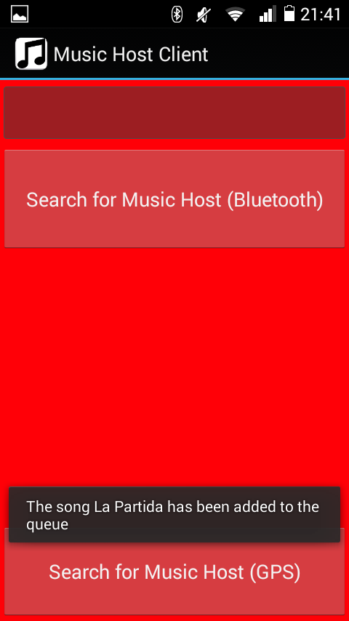
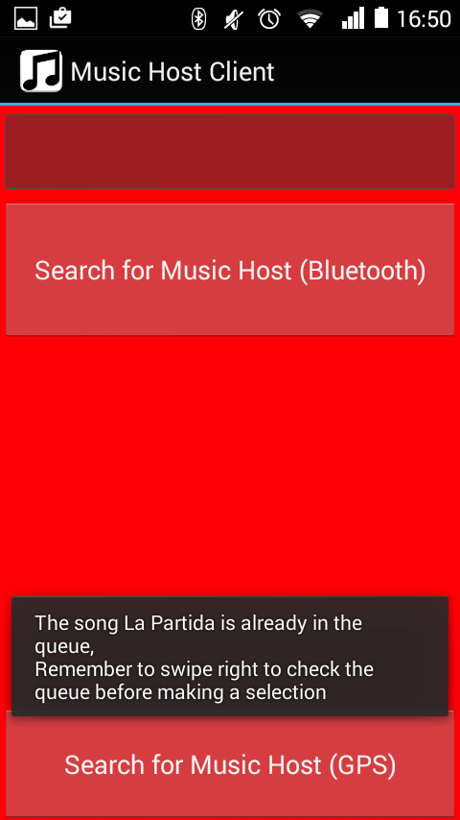
MUSIC HOST CLIENT USE CASE – SONG ACCEPTED / NOT ACCEPTED
Message From Host

Slide 18
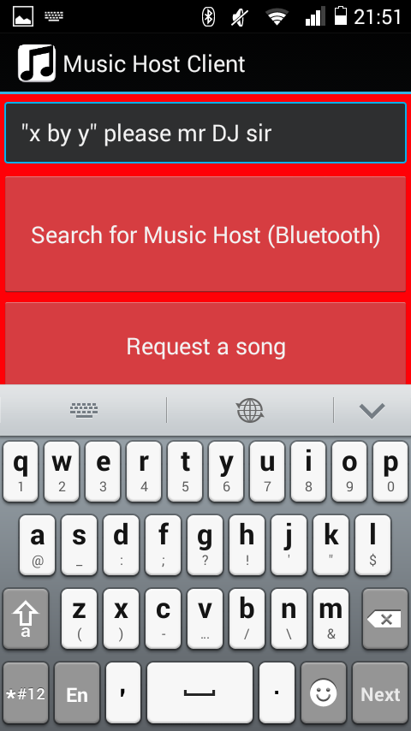
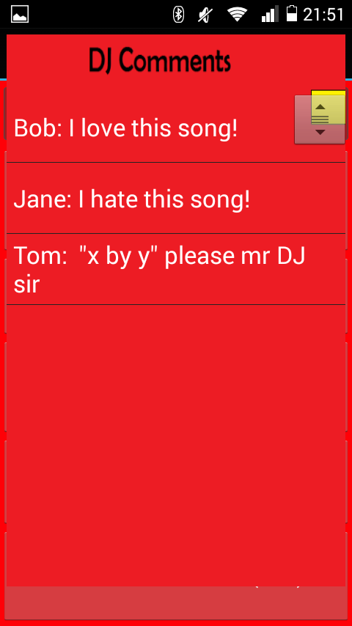
MUSIC HOST CLIENT USE CASE – DJ Comment
Button Clicked

Slide 19
Conclusion
Goals
Demonstration of abilities
Experience with Invention
Introduced to new APIs, tools and methodologies
Reflection
More focus on control methods
Develop more synchronization with user
My conclusion
Project is a product of my abilities and personality
Realisation will never be what you expect

Slide 20
Experiments
Test Practicality and Usability of Application
Developing a purpose
Directions the application could have took
Adding Gameplay Mechanics
Application as a Game
Feasibility and Entertainment tests
Midi Instrument
If the application had been midi based
Usability as an instrument

Slide 21
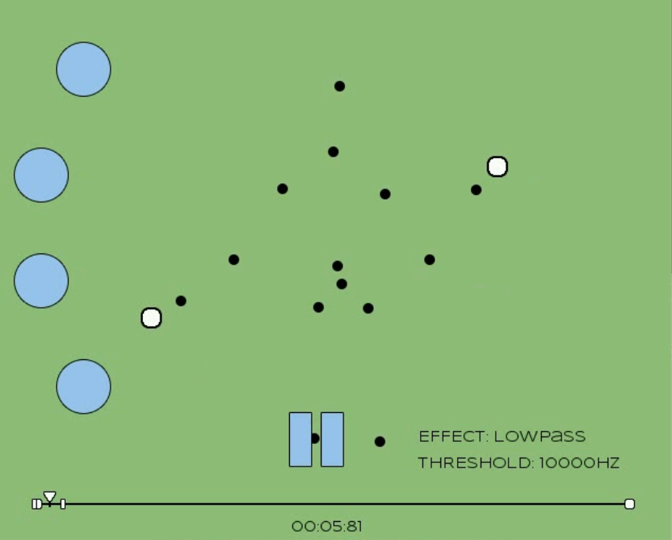
Experiment 1 – Gameplay Mechanics
Looping Track Sections
Turn on effect to break
Feasibility
Mechanics functional
Application operational
Entertainment
Not in sync with tracks
Conclusion
Difficult to link mechanics

Slide 22
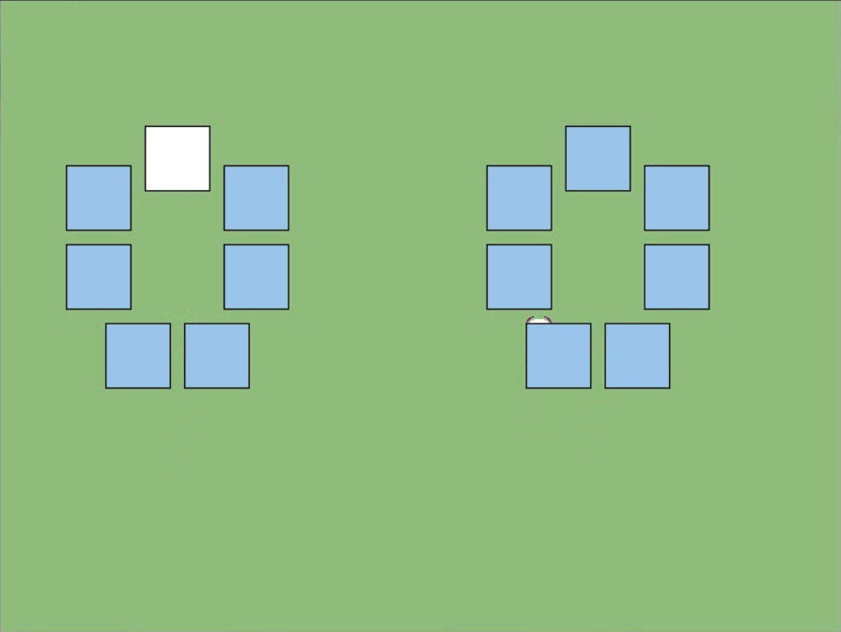
Experiment 2 – Midi Instrument
Kinect Midi Generator
Instrumentation
Usability
Lack of control resolution
Reduction of inputs
Conclusion
Compensation of control
Reduction of playability

Slide 23
References
KinectSDKBook4CPP – github
Channel9 MSDN Kinect Tutorials
Focus On SDL – Ernest Pazera
FMOD Ex Examples and Documentation
Freshfunkee.wordpress.com
Github.com/freshfunkee
Youtube.com/ejoy50

